Slide 1



Научный совет РАН по комплексной проблеме
"Физика низкотемпературной плазмы"
Заседание 11 ноября 2019 г.
Президиум РАН, г. Москва
Диагностика сверхплотной нагретой плазмы
создаваемой лазерными импульсами петаваттной мощности
Пикуз Сергей Алексеевич
Объединенный институт высоких температур РАН
Национальный исследовательский ядерный университет «МИФИ»
Notes:
http://www.kansai.qst.go.jp/icxrl2016/

Slide 2
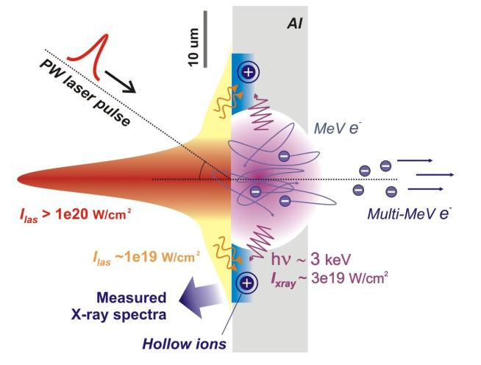
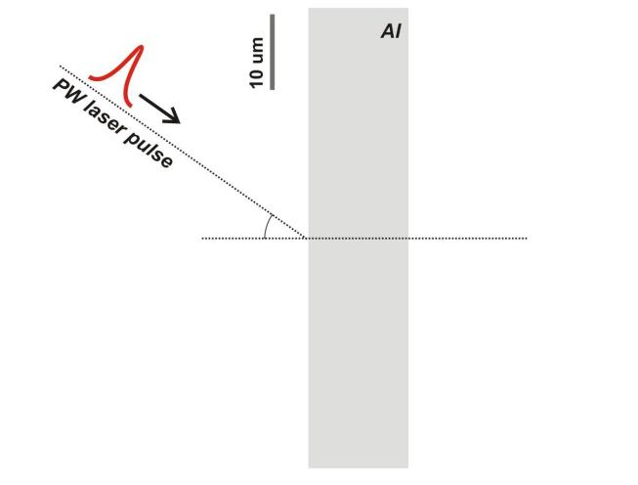
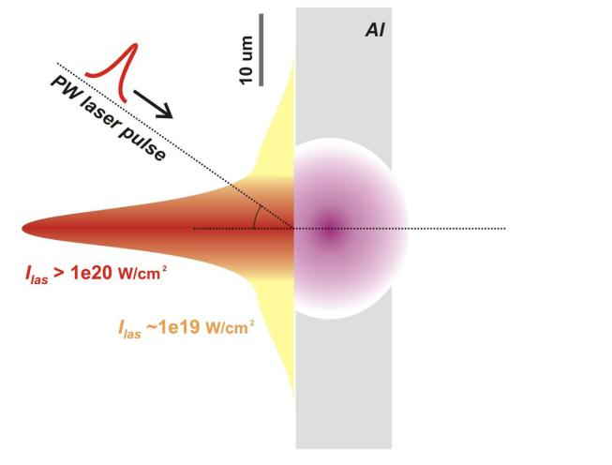
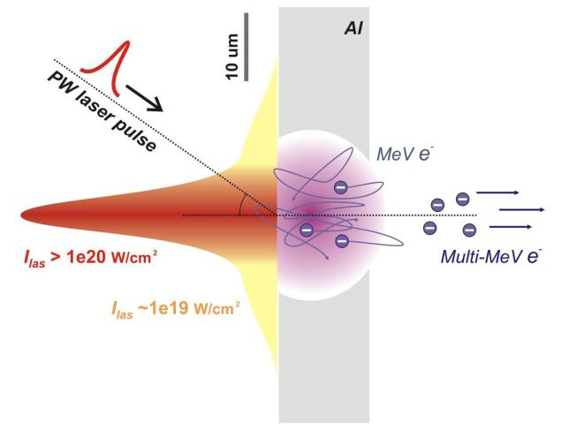
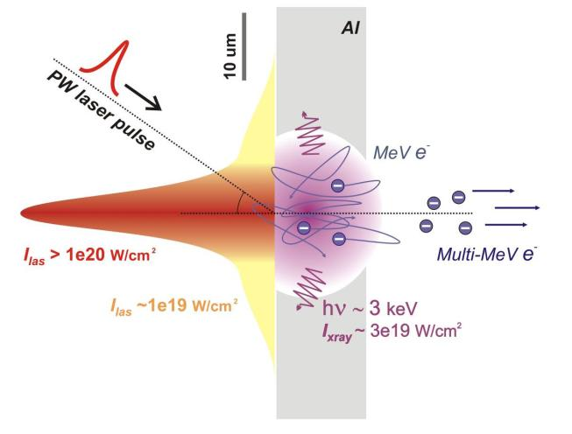
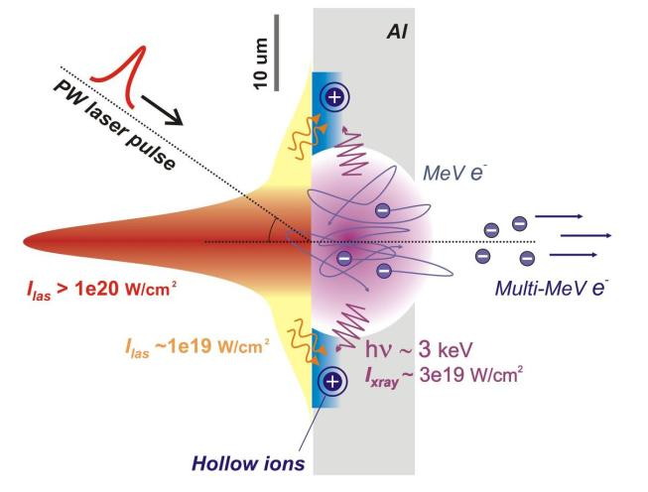
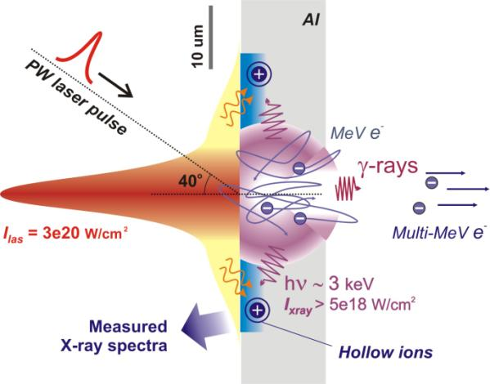
Physics behind PW laser pulse interacting with solids

Slide 3
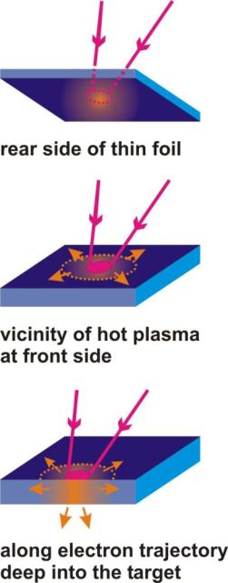
WDM studies using optical lasers – principle and setup
Hot plasma (T_{e} ~ 1 keV), commonly in laser focus
WDM – (T_{e} ~ 10-100 eV, N_{e}~10²³ cm⁻³)
Hot plasma
T_{e}^{hot} ~ 500 – 5000 eV
X-rays
hot
electrons
Warm plasma
T_{e}^{warm} ~ 1 - 30 eV
X-rays
By means of X-ray spectroscopy
T_{e}^{warm} can be determined when over 10 eV.
Spatial resolution is of crucial importance.

Slide 4
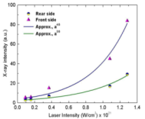
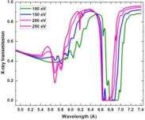
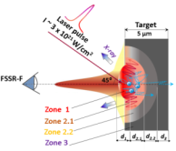
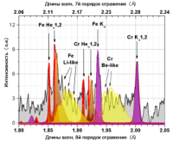
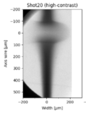
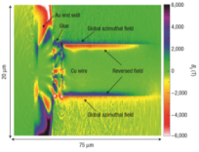
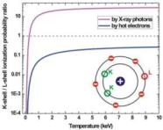
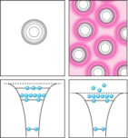
X-ray imaging and spectra diagnostics capabilities
X-ray emissivity and
X-ray transport properties
Hot and warm plasma
temperatures
Plasma density -
shocks and electron currents
Atomic states and
density effects (hollow ions, IPD)

Slide 5
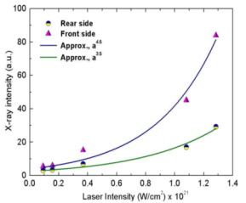
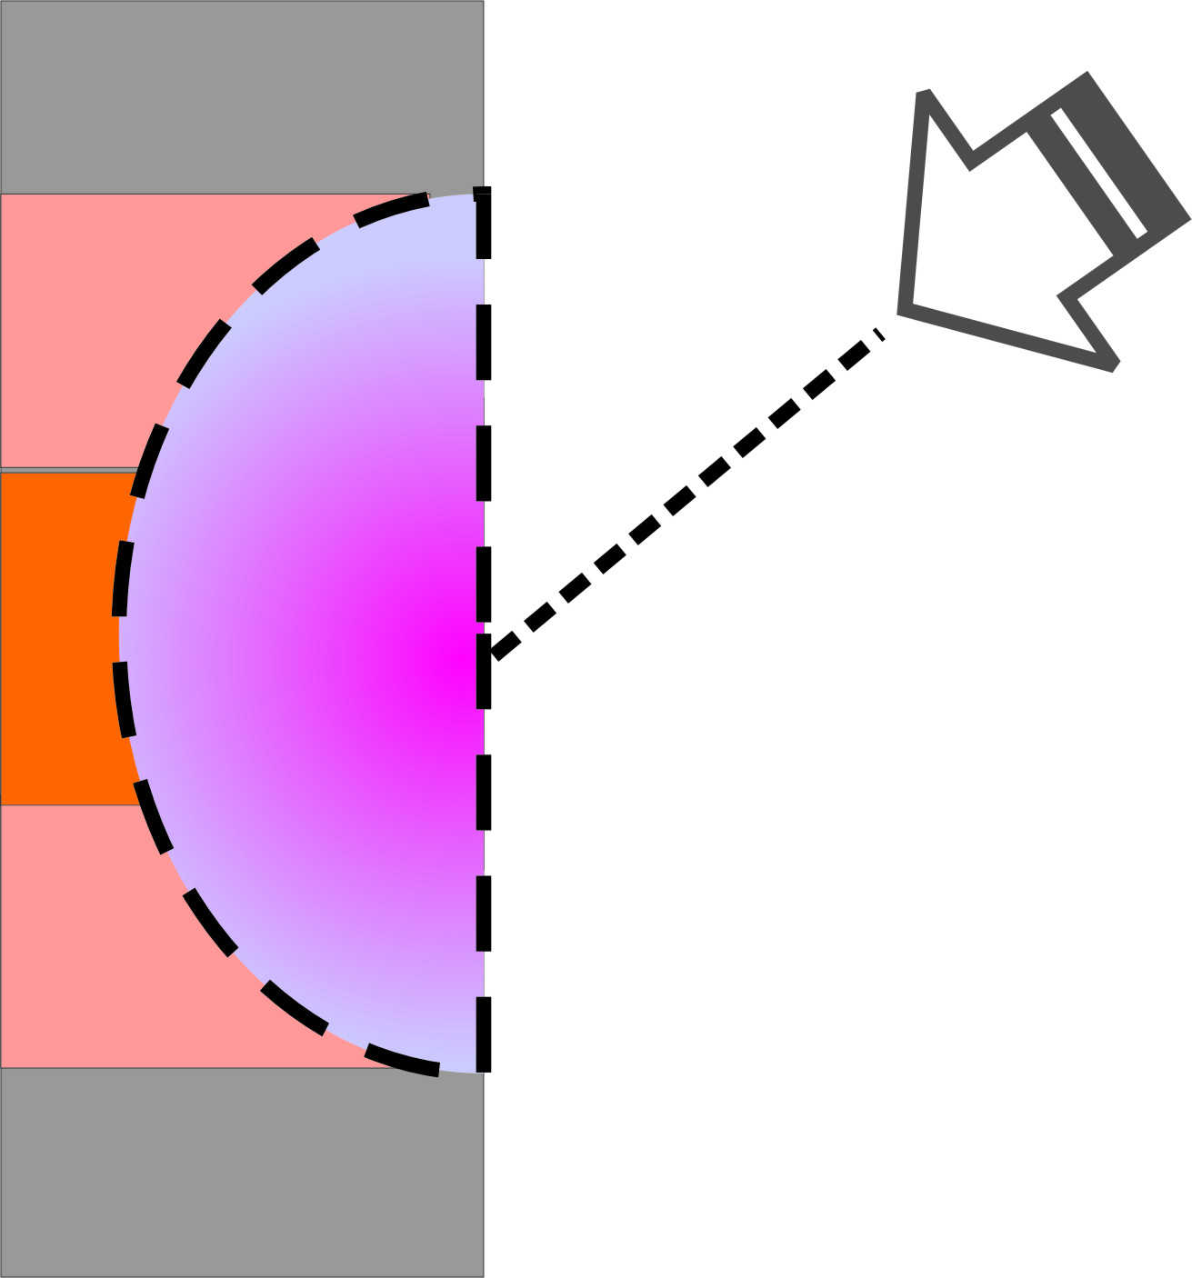

X-ray emissivity and
X-ray transport properties

Slide 6

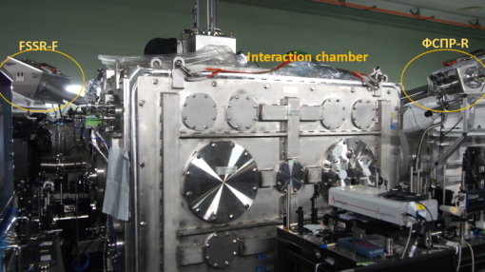
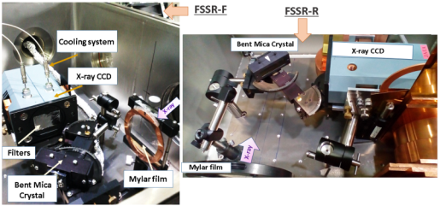
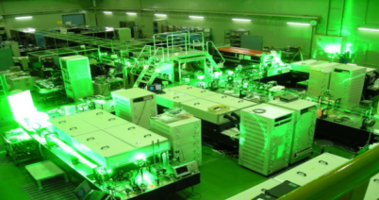
Experiments with J-KAREN-P Laser facility
Experiments at J-KAREN-P (since march 2016)
Kansai Photon Science Institute, Kyoto, Japan
J-KAREN-P laser facility:
High resolution X-ray spectrometers coupled with CCDs, 2 channels
Ti:Sapphire, OPCPA
Wavelength λ= 800 nm
Laser power Plaser= 0.35 PW
Laser contrast up to Claser ~ 10¹²
Pulse duration τ ~ 40 fs
Energy on target up to Е~ 14 J
FSSR in vacuum chamber

Slide 7

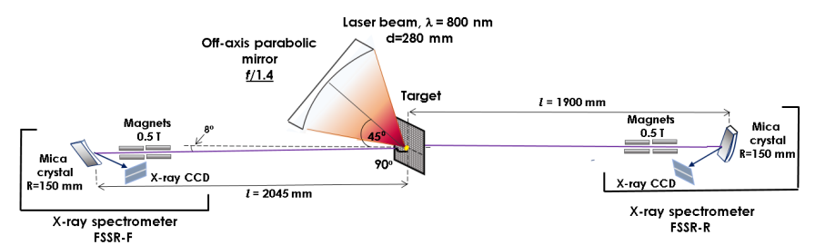
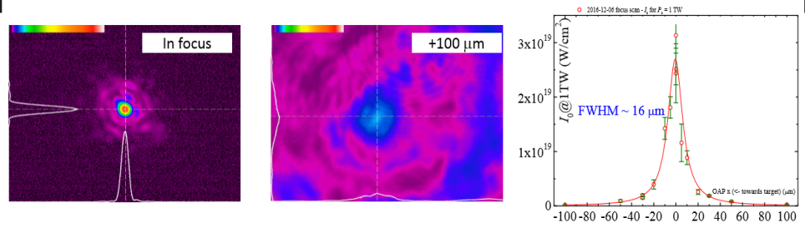
Experimental Setup J-KAREN-P laser facility
Sharp laser focusing with f/1.4 parabola. Focal spot diameter ~1,5 μm
Focal spot snaps
Laser intensity on target vs target shift

Slide 8
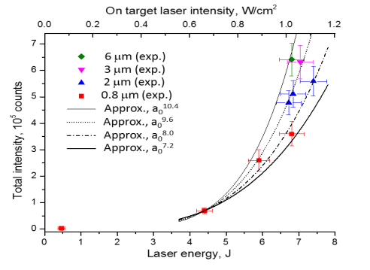
Al x-ray spectra measurements @ J-KAREN
Nonlinear growth of X-ray intensity in 1.5-2 keV band is observed
for laser intensity I_{las} ranged from 2e20 W/cm² to 1.1e21 W/cm²
I_{X-ray} ~ a₀⁸, or I_{X-ray} ~ E_{las}⁴
// A.Ya. Faenov et al., Scientific Reports. 5, (2015)
$$normalized laser field −a_{0}= eE_{Las}/ mcω$$
Notes:
In some sense similar picture was observed with PW femtosecond laser pulses in our experiment at J-KAREN facility.
Here the same Al targets were exposed to over6e20 W/cm2 intensities. The difference in the spectra is in the shift from KK to KL hollow ion states abundance. The effect is easily predictable, as short pulses effectively generates fast electrons, and electron distribution in plasma becomes far less Maxwellian. So KL hollow ion geneation by fast electrons competes with KK hollow ion production by X-rays. But what is more important, that in this campaign we were able to test how the overall observed X-ray yield depends on the intensity of the laser field. And - the predicted power dependence of E^4-5 was experimentally confirmed.

Slide 9
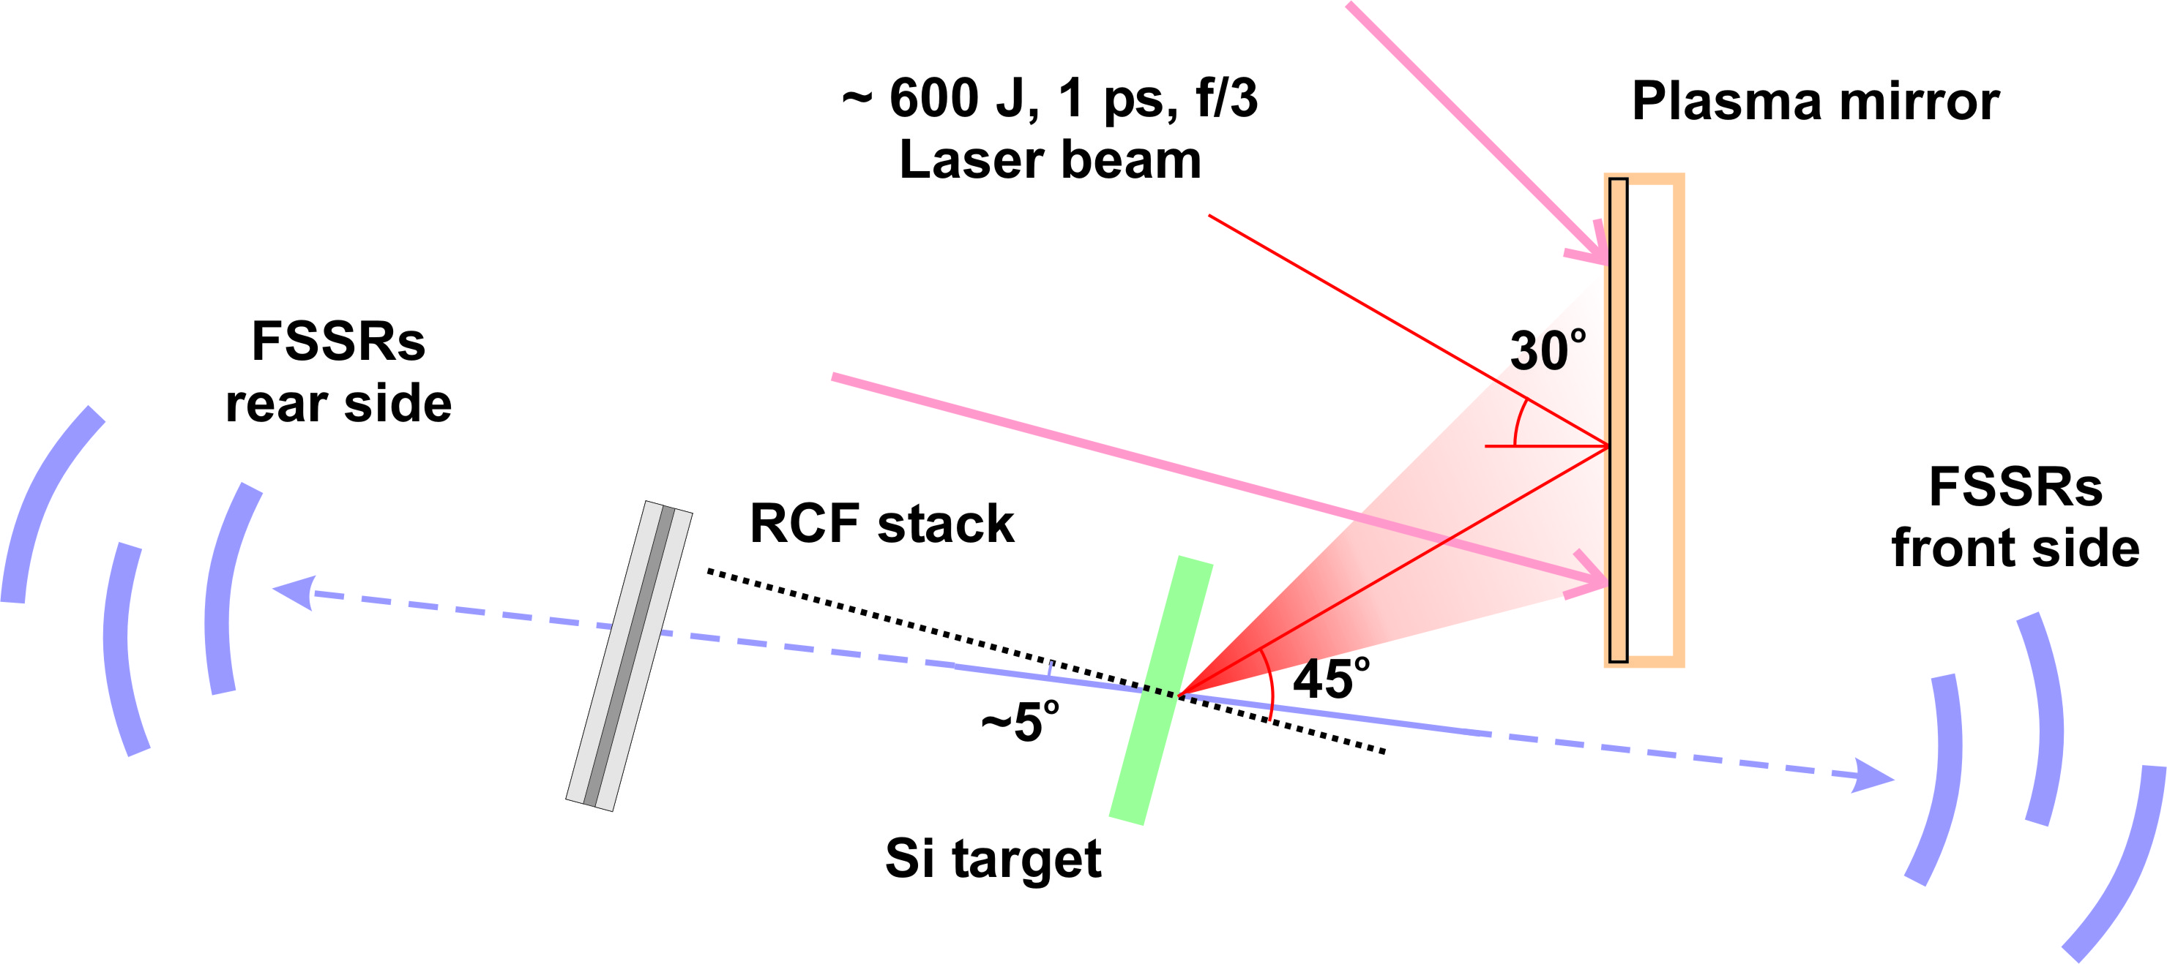
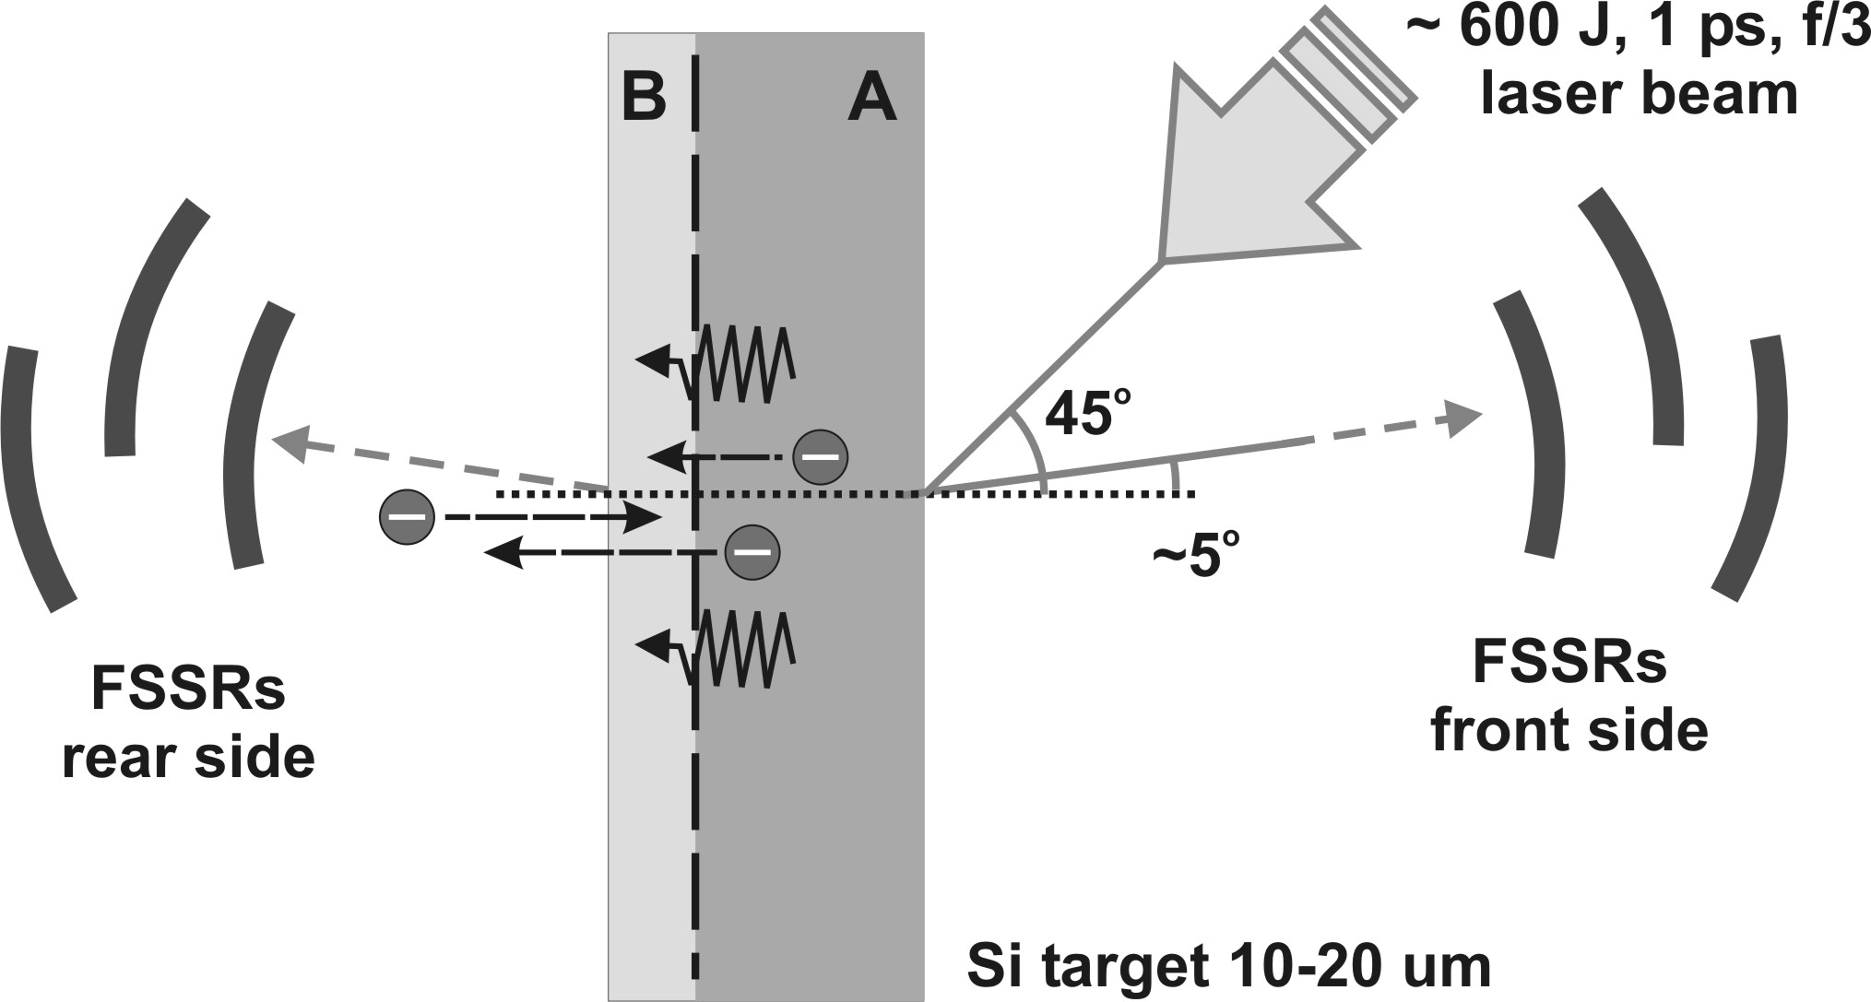
X-ray spectroscopy studies of solid-density PW plasma
Experiment @ Vulcan PW: 5e20 W/cm2, 600J @1ps,
OPCPA + plasma mirror to ensure ultra high pulse contrast
Combination of 3 FSSRs at each side aligned at merged bands
in order to cross-calibrate and combine the spectra.

Slide 10


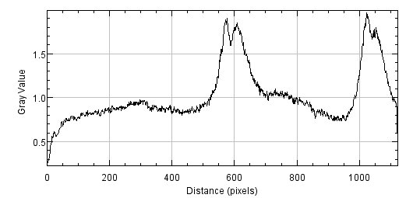
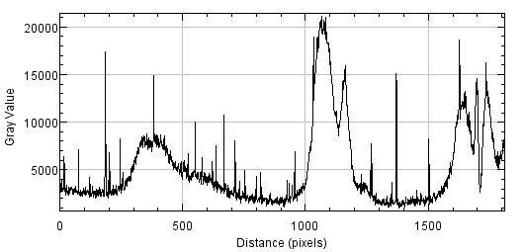
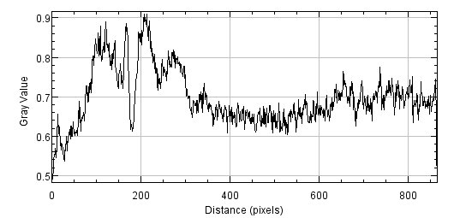



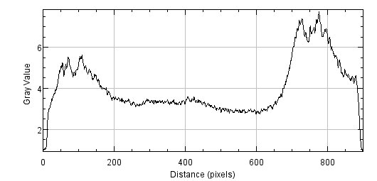
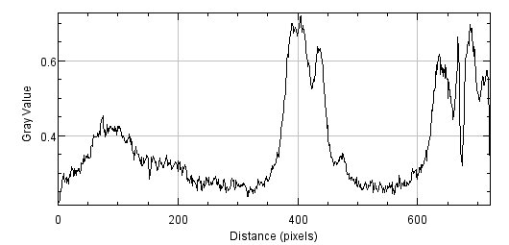
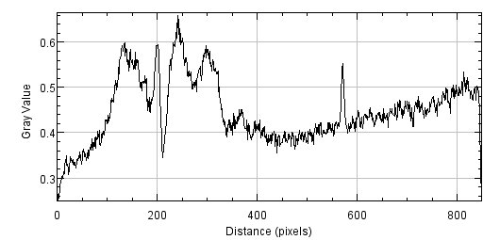
Shot23
Target: CH 3um + Si 2um + CH 3um | Energy: 550.1 J | Focal spot diameter: 7 um | Pulse length : 1.9 ps
FShort
FMiddle (CCD)
FLong
RShort
RMiddle
RLong

Slide 11
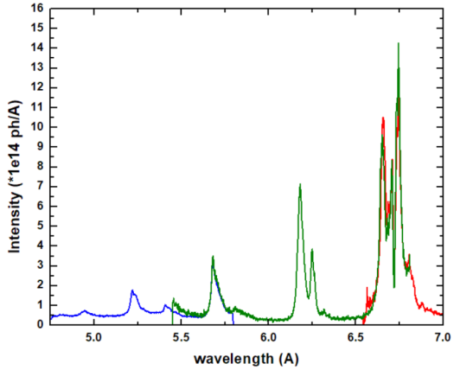
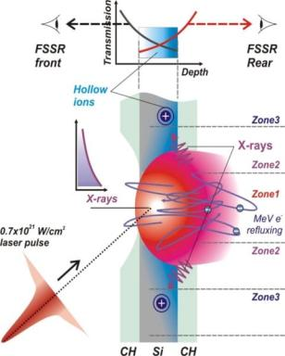
Revealing absolute intensity of X-ray source
2e14 ph/A/2p corresponds to E_{X-rays} = 0.5 J (in 2-3 keV photon energy range)
Assuming X-ray emission time ~ 1 ps laser pulse duration:
I_{Xrays} ~ 0.2e18 W/cm² - as observed in the direction close to the target normal

Slide 12
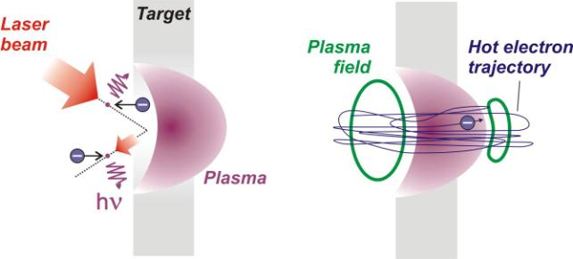
X-ray generation in PW plasma
E_{laser}, i.e. Thomson scattering
at incident laser radiation
E_{plasma-transv}, i.e. Bremsstrahlung
in a plasma during refluxing
With I_{Las} = 3e20 W/cm² I_{Xray} ~ 5e18 W/cm²
to be estimated
Refluxing is very important to increase the electron flux inside the plasma.
Thin (~ μm) targets is more effective due to higher electron oscillation frequency.

Slide 13
X-ray transport properties of laser-initiated WDM

Slide 14
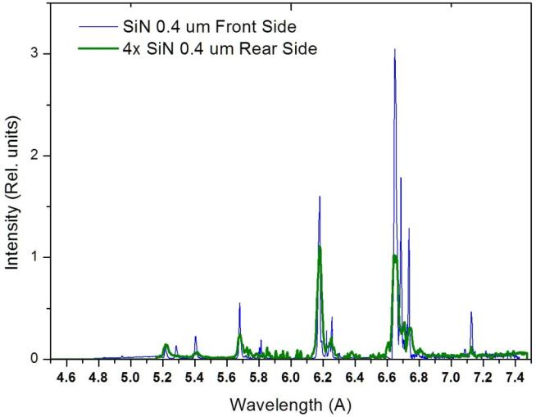
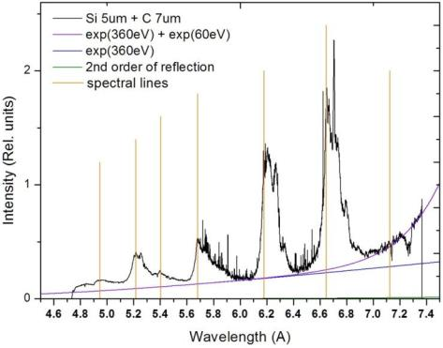
Absorption spectroscopy
Si Heα
SiLyα
SiKα
SiHeβ
SiLyβ
SiHeγ

Slide 15
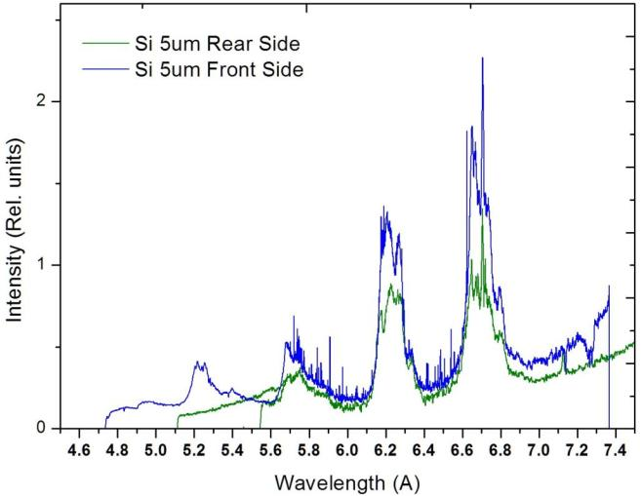
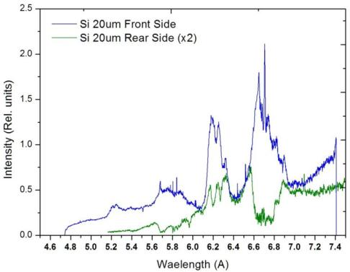
Absorption spectroscopy

Slide 16

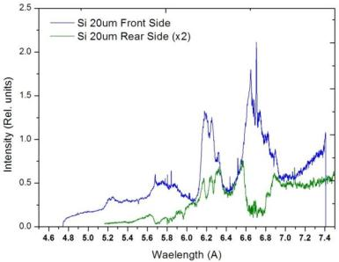
Absorption spectroscopy
Si Heα
Si Heβ
T_{e} up
T_{e} up

Slide 17
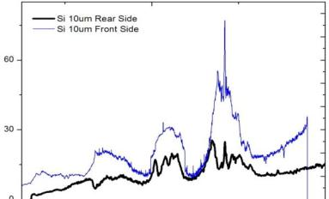
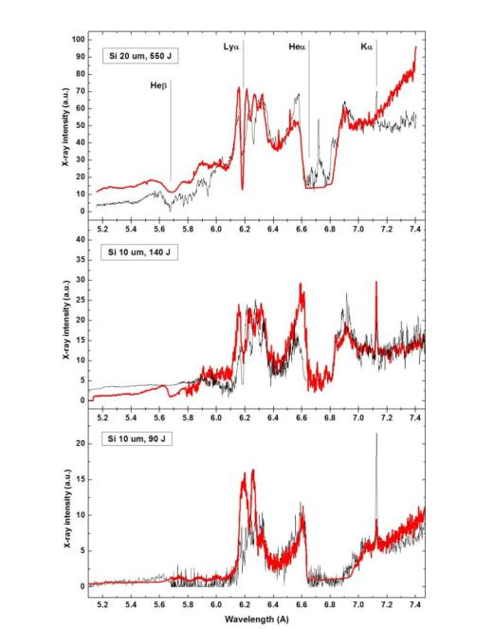
Absorption spectroscopy
The spectra from the rear
are simulated with use of PrismSPEC
absorption mode, when the initial
front side spectra is taken for the source
T_{e} = 320 eV (20 um, 550 J pulse)
d_{b} = 5 um
T_{e} = 300 eV (10 um, 140 J pulse)
d_{b} = 5 um
T_{e} = 140 eV (10 um, 90 J pulse)
Often, the spectra could not be described
in-full by a single Te – as H-like and He-like
lines are absorbed differently, i.e.
by different plasma zones.

Slide 18
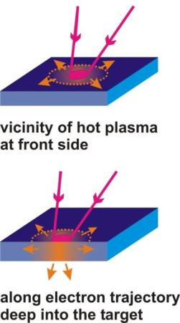
WDM Temperature measurements
Hot plasma
T_{e}^{hot} ~ 500 – 5000 eV
X-rays
hot
electrons
Warm plasma
T_{e}^{warm} ~ 1 - 30 eV
X-rays

Slide 19
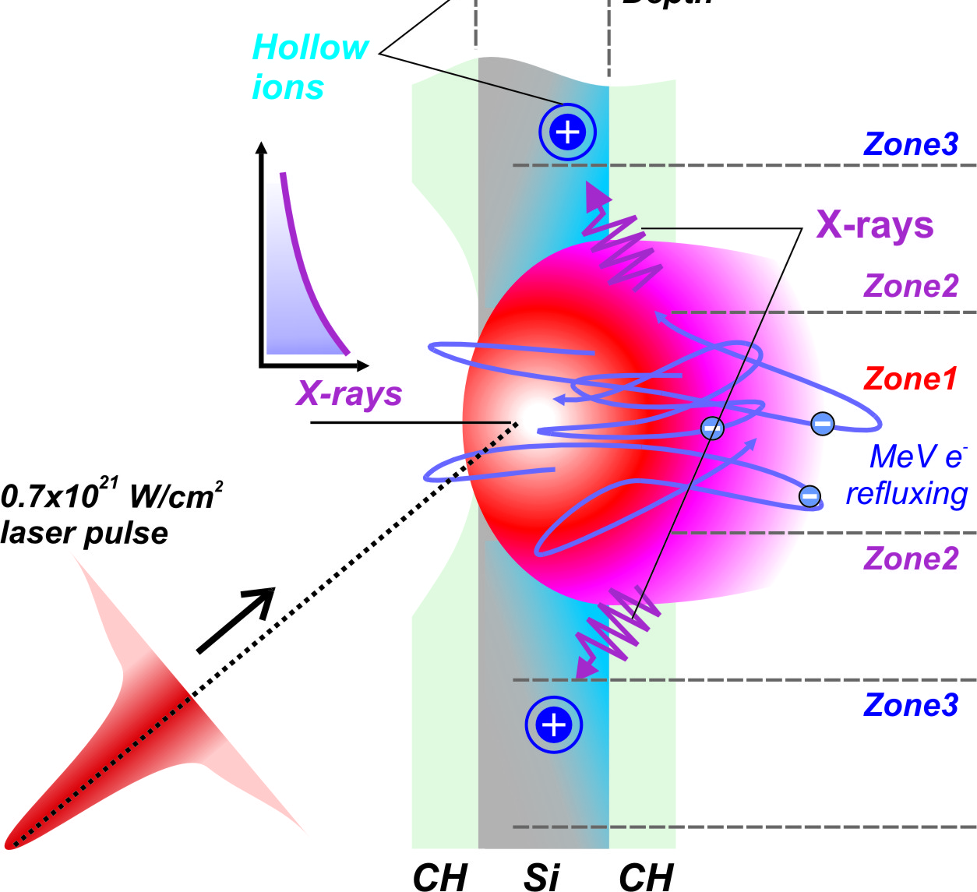
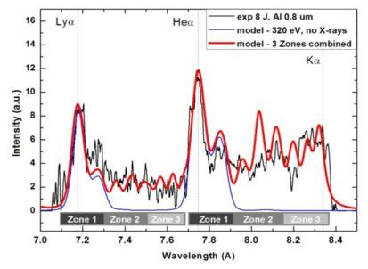
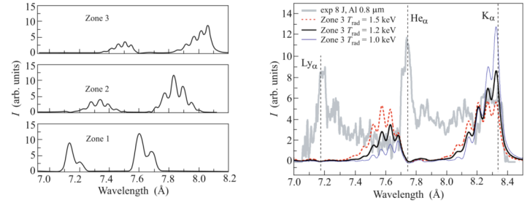
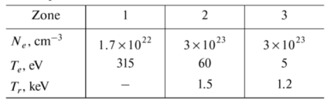
Experiment at PEARL facility
E = 10 J, τ = 60 fs, d_{foc} = 6 um,
I = 4e20 W/cm2

Slide 20
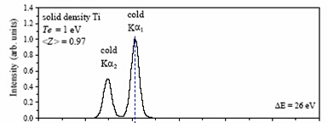
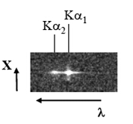
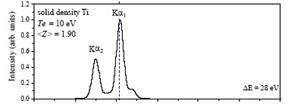

X-ray specs diagnostic capabilities
Satellites to “cold” Kα-line:
T_{e}= 1 eV
+
T_{e}= 10 eV
As the temperature of the solid increases,
M/N-shells of atoms ionize and characteristic
K-shell lines shift to higher energies.
For Ti - removing 4s electrons produces
a shift of only ~ 1 eV, while removing
M-shell 3l electrons produces a ~4 eV shift.
T_{e}= 20 eV
Spectral resolution of δλ/λ ~ 3000 ÷ 5000
is in demand.
To create K-shell vacancy is not an issue for high intensity laser plasma
due to a high yield of fast electrons

Slide 21
WDM studies using optical lasers – principle and setup
Hot plasma (T_{e} ~ 1 keV), commonly in laser focus
WDM – (T_{e} ~ 10-100 eV, N_{e}~10²³ cm⁻³)
Hot plasma
T_{e}^{hot} ~ 500 – 5000 eV
X-rays
hot
electrons
Warm plasma
T_{e}^{warm} ~ 1 - 30 eV
X-rays
By means of X-ray spectroscopy
T_{e}^{warm} can be determined when over 10 eV.
Spatial resolution is of crucial importance.

Slide 22



Particular realization – free standing wire target
Ti wire of Ø50 um and polished tip
PHELIX laser beam used:
- 200 J on target, 1 ps pulse duration
- focused by off-axis parabola to ~5 um spot Ø
- on polished tip of the wire
- high pulse contrast of 1e6-1e10 on demand

Slide 23



Experimental results - references
Heα
Kα1
Ti Lyα sat.
Ti Heα
Ti Kα
x
Heα
Ti K-edge
Reliable and precise references
for spectral dispersion:
K-edge of absorption, neutral Kα1.
Positions of Kα-satellites can be
measured with 1 mÅ precision
Kα1

Slide 24


Experimental results - references
Heα
Kα1
Inter.
Hea
Li-like sat.
~ 1000 eV
Be-like sat.
10-50 eV
Area of WDM isochorically heated by hot electron flow only
is certainly distinguished from that one heated by the laser

Slide 25

Spectra simulation issues
First spectra simulations for WDM radiation applied configuration-averaged MUZE model
// S.B. Hansen et al., PRE 72, 036408 (2005)
Several synthetic DL/CA approaches are developed, particularly with a combination of NLTE FLYCHK and FLYSPEC codes // M. Murillo et al. PRE 87, 063113 (2013)
T_{e} values obtained ago with use
of simplified models overestimate
the actual heating of WDM
~ 1.5-2 times.

Slide 26



Experimental results – T_{e} measured
0.5 ps, 200 J, 6 um focusØ
I ~ 5e20 W/cm²
In both cases highest T_{e} achieved by
isochoric heating is of ~50 eV,
which is in general below expectations

Slide 27





x
X-ray emission spatial range and hybrid simulations
λ
x
To reveal the correct potential barrier
on the wire edges we have to spot
the expanding wire shape in experiment
Hybrid simulation data employing
electrostatic barrier at wire surface
Kα is emitted not far then ~1 mm deep:
3D simulation of fast electron currents
in mass-limited targets is needed

Slide 28



X-ray radiography to measure
plasma density and hydrodynamics of WDM

Slide 29



X-ray radiography approach

Slide 30




X-ray radiography data for wire target

Slide 31





Early expansion, inhomogeneous heating / e-currents
2.2 ns delay
// J. Green et al.
Nature Phys 3 (2007)

Slide 32


Exotic atomic states and solid
density effects

Slide 33
X-ray spectroscopy studies of solid-density PW plasma
Experiment @ Vulcan PW: 5e20 W/cm2, 600J @1ps,
OPCPA + plasma mirror to ensure ultra high pulse contrast
Combination of 3 FSSRs at each side aligned at merged bands
in order to cross-calibrate and combine the spectra.

Slide 34



Effect of ionization potential depression
Spectra modeled by PrismSPECT code –
considering and excluding IPD effect
Hummer and Mihalas model
for occupation probabilities
// Astrophys J., 331 (1988)

Slide 35


Spectral features depending on type of the target

Slide 36



Stark broadening consideration
SiN3 0.5 um foil,
uncoated
Ni = 2(±0.5)E21 ion/cm³
dE/dv ~ 1.5-2.5 × 10⁶ J/cm³
Si 2 um,
uncoated
Ni = 2.8(±0.4)E22 ion/cm³
Si 2 um coated
with 1.4 um CH
Ni = 4.2(±0.4)E22 ion/cm³
dE/dv ~ 5 × 10⁷ J/cm³

Slide 37





X-ray spectra depending on plasma density

Slide 38



Verifying ionization potential depression model

Slide 39
Radiation dominated matter
Radiation Dominated Regime of matter -
when plasma radiation dominates particle dynamics
// C.P. Ridgers et al. PRL 108, 165006 (2012). L.L. Ji et al. PRL 112, 145003 (2014), ….many
+ up to 30% of optical laser radiation could be transformed to γ -ray flash)
To reach RDR – the laser field should reach 1e23-1e24 W/cm² intensity ☹
Radiation Dominated Kinetic Regime -
when plasma radiation processes dominate atomic kinetics
// J. Colgan et al., PRL 110, 125001 (2013)
To reach RDKR – the laser field of ~ 1e21 W/cm² should be enough ☺
Plasma produced by intense XFEL beam is a good example of RDKR.

Slide 40

High-temperature plasma under external intense X-rays
X-Ray photons preferentially ionize inner shells rather than outer shells
Exotic hollow atom states – the states with a number of K and/or L shell vacancies, but still populated outer shells
KK Hollow ion spectra can be dominant in the plasma emission
if there is an ultra-bright X-ray source

Slide 41
WDM with exotic atomic states due to intense X-rays
1. Direct excitation by ultra-intense X-ray laser or XFEL pulses
Production of Hollow ions in warm dense matter by inner shell photoionization
XFEL X-ray radiation
2. Indirect excitation by visible ultra-intense laser pulses
Production of Hollow ions in warm dense matter by electron or ions collisions or inner shell photoionization
Ultra-intense optical laser
radiation
Relativistic plasma –generation of ultra-intense fast electrons and X-ray beams
Warm dense plasma

Slide 42
High-n hollow atom states and radiation transitions
H-like
He-like
Li-like
Spectral map
3l
3lnl
2l
3lnl²
Resonance and Rydberg resonance transitions
2lnl
Ly_{α}
He_{α}
2l3l
Ly_{β}
He_{β}
Ly_{α}
Ly_{β}
2l²
Satellites
1s
.
1snl
.
.
1s3l
1snl²
Rydberg
satellites
1s2l
1s3lnl
1s2l3l
KK-Hollow ion transitions
He_{α}
He_{β}
1s2l²
KK-Rydberg
hollow ion transitions
1s²
.
.
1s²nl
.
1s²3l
5.2
5.6
6.0
6.4
6.8
resonance transitions
Rydberg resonance transitions
satellites
Rydberg satellites
1s²2l
hollow ion transitions
Rydberg hollow ion transitions
Notes:
Sent to Colgan 2015-11-27.
answer 2015-1-30: Hi Anatoly,
I haven’t yet had a chance to start the paper, but I hope to towards the end of this week. I plan to first make the figures
that we will show and once I have those I’ll send them to you for your comment. Your figure looks good !
James

Slide 43





Hollow atom spectroscopy, principles
e
e
Exotic hollow atom states may be created
by hot electron flow or X-ray radiation
(external beam or plasma itself of)
e
e
+
e
+
e
First observation in laser plasma
– 1997, LANL, 1e19 W/cm2
e
e
Target heating prior inner-shell excitation should be avoided - High contrast of
a laser pulse is important
e
e
Hollow atom spectral lines induced by intense
quasi-monocromatic X-ray radiation of LCLS
K⁰L²
Lyα
K⁰L³
KK hollow
atom lines
KL hollow
atom lines
30 eV
40 eV
50 eV
// S.M. Vinko et al., Nature 482, 59 (2012)
// F.B. Rosmej et al,
J.Phys.CS 72, 012007 (2007)
Becomes very significant for high intensity lasers

Slide 44
Hollow atom generation in PW plasma
Refluxing is very important to increase the electron flux inside the plasma.
Thin (~ μm) targets is more effective due to higher electron oscillation frequency.

Slide 45






Hollow atom spectra observation
KK hollow
atom lines
KL hollow
atom lines
KK hollow
KL hollow
I _{max}= 3×10²⁰ W/cm²
Laser energy – 160 J on target
Pulse duration – 0.7 - 1.2 ps
1ω = 1054 nm
High contrast of OPCPA
Vulcan PW laser
[*] U. Andiel et al., Appl. Phys. Lett. 80, 198 (2002)

Slide 46









NLTE ATOMIC spectra simulations
// J. Colgan et al. High Energy Density Physics 7, 77 (2011)
No X-ray radiation, No hot electrons
5 keV electrons tail, No X-rays
Ultra intense keV X-rays
bulk T_{e} = 55 eV
N_{e} = 3x10²³ cm⁻³
5% of 5 keV electrons
Combined

Slide 47


Parameters of X-ray source via hollow atom spectra
Radiation temperature
Source brightness
Varying Trad in 0.5 – 5 keV range
Testing Dilution factor in 0.01 – 1 range
Confirms the source of I_{xray} > 1E18 W/cm² intensity and T_{rad} ~ 3 kev existing

Slide 48







Collaboration
Joint Institute for High Temperatures RAS, Russia
A.S. Martynenko, I.Yu. Skobelev, M.A. Alkhimova, S.N. Ryazantsev,
E.D. Filippov, S.S. Makarov, M.D. Mishchenko
York Plasma Institute, University of York, UK
P. Durey, L. Doehl, L. Antonelli, P.D. Farley, C. Baird, C.D. Murphy,
K. Lancaster, N. Woolsey
SUPA, Department of Physics, University of Strathclyde, UK
N.M.H. Butler, R.J. Dance, P. McKenna
CELIA, University of Bordeaux, CNRS-CEA, France
F. Barbato, G. Boutoux, L. Giuffrida, T. Sakaki, J.J. Santos, A. Sauterey,
D. Batani
GSI Helmholtzzentrum für Schwerionenforschung, Germany
P. Neumayer, K. Li, D. Khaghani, V. Bagneux
CLF, STFC Rutherford Appleton Laboratory, UK
N. Booth, D. Heathcote, C. Spindloe
Kansai Photon Research Institute QST, Japan
M. Nishiuchi, H. Sakaki, A.S. Pirozhkov, A. Sagisaka, N.P. Dover,
Ko. Kondo, K. Ogura, Y. Fukuda, H. Kiriyama, M. Kando, K. Kondo

Slide 49






Collaboration
Institute of Applied Physics RAS Russia - A. Soloviev, K. Burdonov, A. Eremeev, A. Sladko, R. Osmanov, M. Starodubtsev, V. Ginzburg,
A. Kuz’min, A. Sergeev, E. Khazanov, A. Shaikin, I. Shaikin, I. Yakovlev
OTRI | ILE Osaka University, Japan
A.Ya. Faenov, T.A. Pikuz, Y. Sentoku, A. Zhidkov, M. Hata, R. Kodama
Sandia National Laboratories, USA
S.B. Hansen
Lawrence Livermore National Laboratory, USA
J. Colgan, J. Abdallah Jr.
Interdisciplinary Graduate School of Engineering Sciences,
Kyushu University, Japan - K. Nishitani, T. Miyahara, Y. Watanabe
ETSI Aeronauticos, UPM, Madrid, Spain
J.J. Honrubia
CEA DAM DIF, Bruyères-le-Chatel, France
A. Debayle
Racah Institute of Physics, Hebrew University of Jerusalem, Israel
A. Zigler
Goethe University Frankfurt, Germany
A. Schoenlein, A. Franz, J. Jacoby, O. Rosmej

Slide 50
X-ray imaging and spectra diagnostics capabilities
X-ray emissivity and
X-ray transport properties
Hot and warm plasma
temperatures
Plasma density -
shocks and electron currents
Atomic states and
density effects (hollow ions, IPD)

Slide 52




Изохорический нагрев плотного вещества (WDM) потоком лазерно-
индуцированных релятивистских электронов в проволочных мишенях
PHELIX laser:
200 J on target,
1 ps pulse, Ø5 um spot
~ 5e20 W/cm2
e
Зарегистрирован прогрев вещества электронами до температур 10-50 эВ на глубине 0.2 ÷ 1.5 мм
Средняя энергия ускоренных электронов ~2.6 МэВ
Определено отношение резистивных и столкновительных потерь энергии электронами
Определена роль возвратных электронных токов и самофокусировки электронного потока в плазменном поле
Опубликовано в Europ.Phys.Lett. 114, 45002 (2016)

Slide 53
Experiment at PEARL facility
E = 10 J, τ = 60 fs, d_{foc} = 6 um,
I = 4e20 W/cm2

Slide 54

Experiments with J-KAREN-P Laser facility
Experiments at J-KAREN-P (since march 2016)
Kansai Photon Science Institute, Kyoto, Japan
J-KAREN-P laser facility:
High resolution X-ray spectrometers coupled with CCDs, 2 channels
Ti:Sapphire, OPCPA
Wavelength λ= 800 nm
Laser power Plaser= 0.35 PW
Laser contrast up to Claser ~ 10¹²
Pulse duration τ ~ 40 fs
Energy on target up to Е~ 14 J
FSSR in vacuum chamber

Slide 55
Experimental Setup J-KAREN-P laser facility
Sharp laser focusing with f/1.4 parabola. Focal spot diameter ~1,5 μm
Focal spot snaps
Laser intensity on target vs target shift

Slide 56

X-ray spectra depend on laser contrast
X-ray spectra of steel plasma allowed to observe laser contrast improvement, which results in appearance of transitions in multi-charged Fe and Cr ions and growth of its relative intensities.
Laser contrast ~10 ¹²
I_{las} = 9e21 W/cm²
Laser contrast ~10 ¹²
I_{las} = 3e21 W/cm²
Laser contrast ~10 ⁶
I_{las} = 3e21 W/cm²
Laser contrast >10 ¹⁰
I_{las} = 1e21 W/cm²

Slide 57
Electron impact ionization
C_{i}N_{e}τ_{plasma} > 1
Here C_{i} is collisional ionization rate, which is strongly dependent on T_{e}
τ_{plasma} ~ L_{plasma}/v_{T}
where L_{plasma} is plasma dimension and v_{T} is plasma expansion speed
high I_{las} is essential,
though not so high as for OFI
T_{e} must exceeds E_{i}/4
To obtain high I_{las} :
1) increase E_{las} expensive
2) decrease R_{focal spot} decreasing of L_{plasma} and τ_{plasma}
The best solution is
to use maximal possible value N_{e} (solid state value)
Very high laser contrast I_{pulse}/I_{prepulse} > 10¹¹ is necessary

Slide 58

X-ray Fe spectra measurements @ J-KAREN-P
X-ray spectra emitted from front/rear sides of 5 μm thickness stainless steel (SUS) foils

Slide 59


Plasma with strong gradients – multiple zones approach
Wavelength 7th ref. order (Å)
X-ray Intensity (a.u.)
Wavelength 8th ref. order (Å)
Zone 1 (Te ~ 2-3 keV)
High temperature plasma created by laser pulse on the focal spot area. Generation of MeV electrons oscillated though the target and bright x-ray photons
Zone 2 (Te ~ 0.1-1 keV)
Plasma with Ne close to solid and Te below than plasma in 1 Zone.
Zone 3 (Te ~ 10-30 eV)
Target regions heated mostly be hot electrons from zone 1. Plasma with lowest Te.

Slide 60

Integrated spectra and revealed plasma parameters
I_{las} = 3e21 W/cm²
Zone | 1 | 2.1 | 2.2 | 3
N_{i} (cm⁻³) | 2×10²¹ | 8×10²² | 8×10²² | 8×10²²
N_{e} (cm⁻³) | 5×10²² | 5×10²³ | 5×10²³ | 2.3×10²³
T_{e} (eV) | 2200 (±120) | 1100(±100) | 300(±50) | 20 (±5)
T_{hot} (keV) | 0.1%, 10 keV | 0.1%, 10 keV | 0.11%, 10 keV | 0.1%, 10 keV
Electron energy density (J/cm³) | 1.04 ×10⁷ | 1.6 ×10⁸ | 5×10⁷ | 9.3×10⁵

Slide 61



Measured spectra - revealing plasma parameters
I_{las} = 9e21 W/cm² – Fe 5 um target
Critical density
No optical thickness
Relativistic critical density
Optical depth 2 um
Solid density
Optical depth 0.5 um

Slide 62



Integrated spectra and revealed plasma parameters
I_{las} = 9e21 W/cm² – Fe 5 um target
Solid density
Optical depth 0.5 um
Zone | 1 | 2 | 3
Ni (cm⁻³) | 8e22 | 8e22 | 8e22
N_{e} (cm⁻³) | 1.9e24 | 1.8e24 | 5.5e23
T_{e} (eV) | 2500(±200) | 900(±100) | 80(±20)
T_{hot} (keV) | 0.1%, 10 keV | 0.1%, 10 keV | 0.1%, 10 keV
Energy density (J/cm³) | 7.8× 10⁸ | 2.6 ×10⁸ | 7 ×10⁶

Slide 63

X-ray yield on energy of laser pulse (spectral range 6.05 – 7 keV)
0.5
1.1
2.3
4.4
6.2
x 10²¹ W/cm²
0.5
1.1
2.3
4.4
6.2
x 10²¹ W/cm²
a₀^{3.0}
a₀^{5.8}
Front side
Rear side
Al target
Low Z (Al); 1.5-2.0 keV range:
I_{X-ray} ~ a₀⁸
High Z (Fe); 6 – 7 keV range:
I_{X-ray} ~ a₀³⁻⁵
Spectral ranges
1.45 – 1.85keV +
2.2 – 2.75keV
Faenov et al. Sci. Rep. 5, 13436 (2015)
Notes:
SIF traces 2017-03-16.opj Folder: Dependences of integral intensity

Slide 64
Solid-density effects
in X-ray spectra
of ultra-relativistic laser plasma

Slide 65
X-ray spectra depend on laser contrast
X-ray spectra of steel plasma allowed to observe laser contrast improvement, which results in appearance of transitions in multi-charged Fe and Cr ions and growth of its relative intensities.
Laser contrast ~10 ¹²
I_{las} = 9e21 W/cm²
Laser contrast ~10 ¹²
I_{las} = 3e21 W/cm²
Laser contrast ~10 ⁶
I_{las} = 3e21 W/cm²
Laser contrast >10 ¹⁰
I_{las} = 1e21 W/cm²
// talk of Maria Alkhimova

Slide 66

Solid-density plasma emission spectra
Line broadening
Rec. continuum lowering
Self-absorption
Satellite structures
Si Heα
SiLyα
SiHeβ
SiKα
SiHeγ
SiLyβ

Slide 67



Revealing the initial density from time-integrated data
Considering the plasma freely expands from the target surface and cools down adiabatically (γ =1.4)
Al Lyβ spectral line profiles calculated
for different stages of plasma expansion

Slide 68


Revealing the initial density from time-integrated data
Using adiabatic plasma expansion
approach the correction factors
are calculated allowing to interpret the
width of Lyb or Heb spectral lines
measured in time-integrated spectra
and to reveal the initial density of
the most hot stage of plasma after the
impact of the main pulse

Slide 69

Dielectronic satellites analysis
The dielectronic satellite structure is highly sensitive to plasma density,
while weakly depending on Te
For optically-thin plasma the ratio between satellite structure and
resonance line intensities determines by Te and weakly depending on Ne

Slide 70




Capability to control laser pulse contrast
No PM
Ni ~ 3e20 cm⁻³
δτ_{pre} ~ 25 ps
PM applied
Ni ~ 1e22 cm⁻³
Assuming HD of plasma expansion (v ~5e7 cm/s)
the plasma density observed in X-rays allows to estimate the time when the preplulse reaches ionization threshold
“δτ_{pre} ~1 ps” ~ τ_{main}

Slide 71
Recombination continuum
Line broadening
Satellite structures
Rec. continuum lowering
Self-absorption

Slide 72

Summary
Several solid-density effects are observed in X-ray spectra emitted by Si targets irradiated by high-contrast PW laser pulses.
Plasma density is measured by means of X-ray spectroscopy analysis showing the effects of different target configuration and further enhancement of the laser pulse contrast
Diagnostic approach helping to estimate the density of plasma in the moment of the main laser pulse impact is developed considering time-integrated spectral data
The effect of ionization potential depression / recombination continuum lowering is observed in the emission of
solid-density Si plasma. The shift of recombination
continuum edge is compared with H&M IPD model
Method of absorption X-ray spectroscopy is developed to study the heating of a matter irradiated by the emission of relativistic laser plasma. Either the temperature of low-emissive WDM can be determined or WDM opacity models can be verified.

Slide 73



Slide 74
Hybrid simulation data, resistive vs collisional losses
Allowing to estimate the effect of refluxing
at wire boundaries, as well as the ratio
between collisional and resistive losses
At first 150 um of the trajectory resistive
losses may exceeds collisional ones by factor of 2.3
“Depression” of isohoric heating of matter at the beginning of MeV electrons
stopping trajectory is still
challenging question

Slide 75

Model is developing…

Slide 76
Spectral features depending on type of the target

Slide 77


X-ray specs diagnostic capabilities, 30-1000 eV range
// S. Hansen et al, MUZE model, Voigt line shapes (2005)
Further M-shell ionization
When L-shell ionization turns on
30 eV
200 eV
50 eV
500 eV
100 eV
1000 eV

Slide 78
WDM studies using optical lasers – principle and setup
Hot plasma (T_{e} ~ 1 keV), commonly in laser focus
WDM – (T_{e} ~ 10-100 eV, N_{e}~10²³ cm⁻³)
Hot plasma
T_{e}^{hot} ~ 200 – 1000 eV
hot
electrons
Warm plasma
T_{e}^{warm} ~ 1 - 30 eV
X-rays
By means of X-ray spectroscopy
T_{e}^{warm} can be determined when over 10 eV.
Spatial resolution is of crucial importance.

Slide 79

Previous observations
Rear-side spectra:
Laser energy – 1-6 J
Pulse duration – 0.5 ps
T_{e}=20 eV
I _{max}= 1 x 10¹⁹ W/cm²
Target – Ti foils 2-50 μm
T_{e} is described
with few eV precision
in the range of 15-25 eV
T_{e}=18 eV
Though the laser intensity
was varied in the range
of 1e16 – 1e18 W/cm²
the temperature increases
just for a few eV.
T_{e}=15 eV
// S.B. Hansen et al, PRE 72, 036408 (2005)

Slide 80
Previous observations
WDM at the front side of laser irradiated bulk solids, in the vicinity of focal spot
// U. Zasrau et al. PRE 81, 026406 (2010)
0.35 ps, 15 J, I ~ 5e19 W/cm²
T_{e} ~40 eV - near the focal spot
T_{e} ~10 eV - at 100 um from the center
Exponential decrease of Ka-line intensity

Slide 81

Experimental results – T_{e} measured
0.5 ps, 200 J, 5 um focusØ
I ~ 5e20 W/cm²
0.7 ps, 200 J, 15 um focusØ
I ~ 4e19 W/cm²
In both cases highest T_{e} achieved by isochoric heating is of ~ 50 eV
Laser power delivered to the target front surface is more important for
the heating of the deep-lying matter, instead of the focusing intensity
(at least in the case of mass-limited target)

Slide 82


Hard X-rays data
Estimations on hot electron energy spectra
using bremstrahlung cannon data
Stopping power of cold Ti for 2 MeV e⁻
is of ~0.6 MeV/mm
T_{hot} measured with tight laser focusing
follows Beg’s scaling law
The stopping range of 3 mm
was expected due to
collisional losses in cold Ti
Hard X-ray data gives the
temperature of hot electron tail
of ~2 MeV (as expected)

